Slide 1
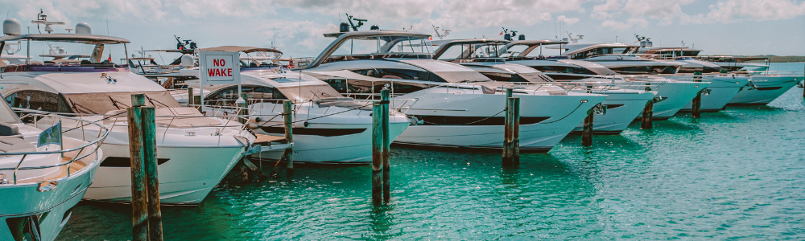
Moffat Bay Island Marina
By Group 2.

Slide 2
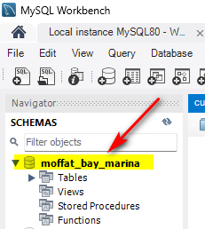
Assignment 5.1
1- Creating the Database
Create the Database: moffat_bay_marina
-- Create the database (if it doesn't exist)
CREATE DATABASE IF NOT EXISTS moffat_bay_marina;
-- Use the database
USE moffat_bay_marina;

Slide 3
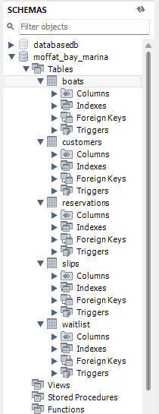
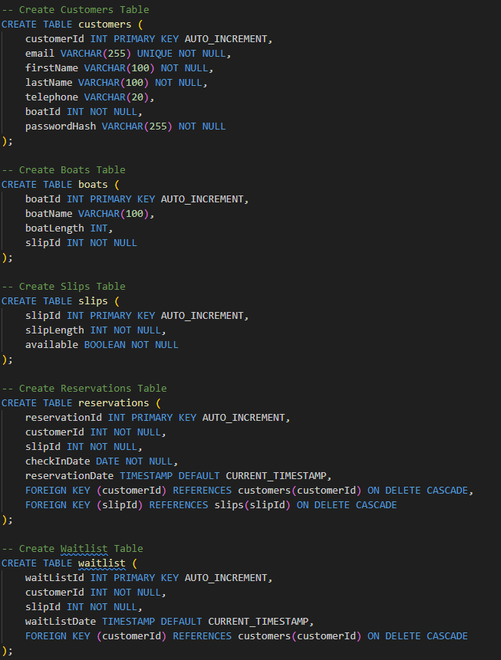
Assignment 5.1
2- Creating the Tables

Slide 4
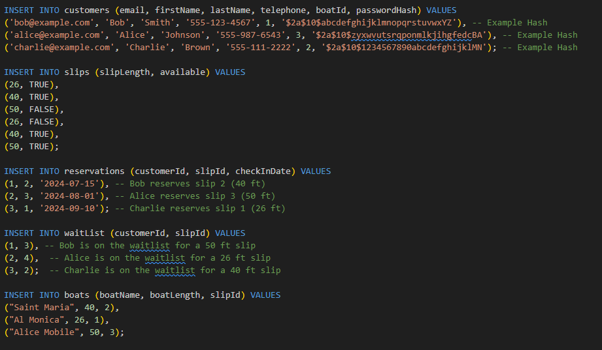
Assignment 5.1
3- Inserting data into Tables

Slide 5
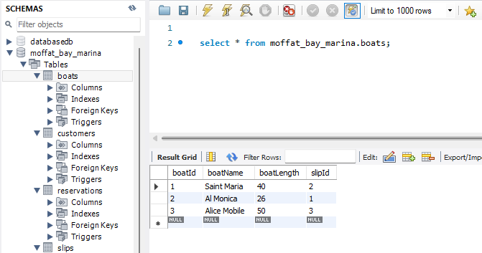
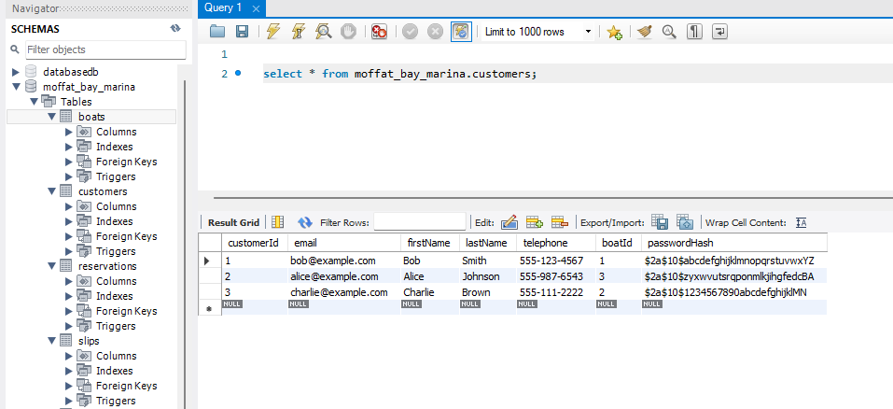
Assignment 5.1
3- Inserting data into Tables

Slide 6
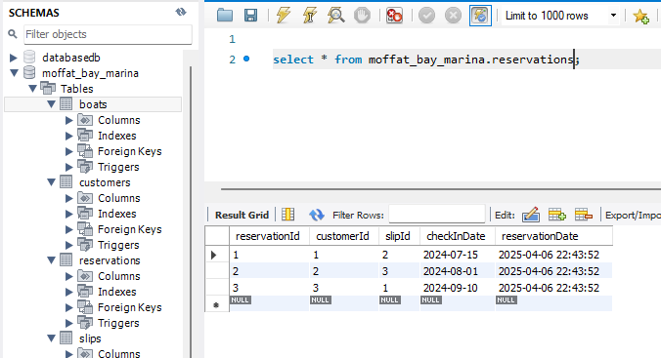
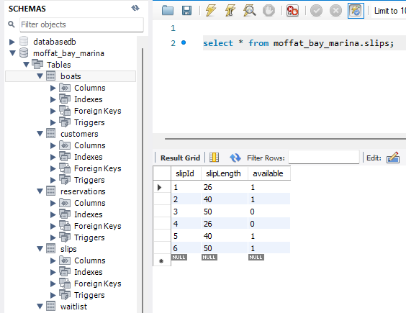
Assignment 5.1
3- Inserting data into Tables

Slide 7
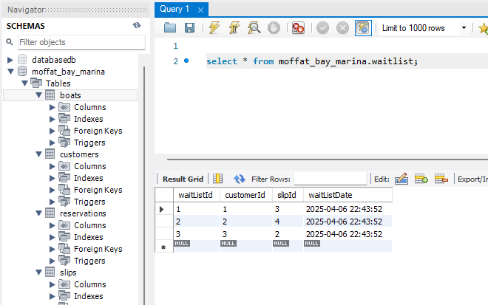
Assignment 5.1
3- Inserting data into Tables

